Slide 1
Case Study of Company X
-V Vignesh Iyer

Slide 2
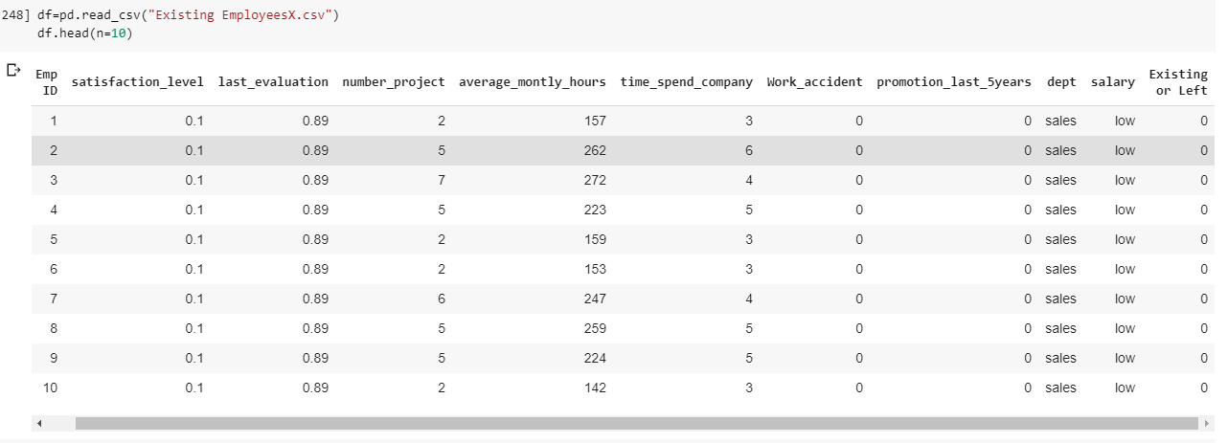
Data of the Company X which is trying to control attrition

Slide 3
Using Data Visualization and Machine Learning on the data provided, we have analyzed the people who are leaving the company X

Slide 4
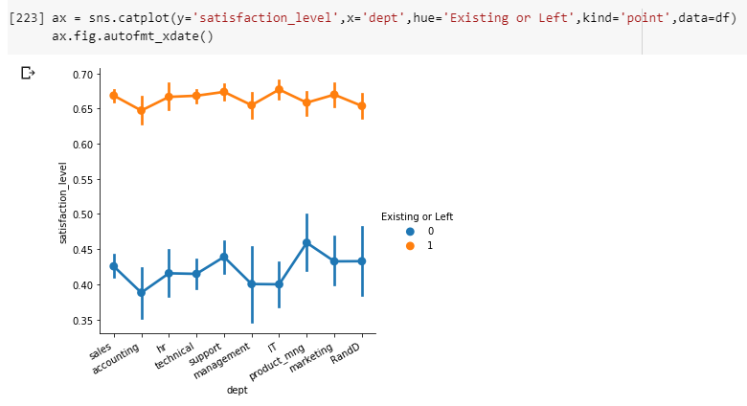
Satisfaction level vs Department
From this graph, we can infer that the employees who are leaving company have satisfaction level less than 0.5

Slide 5
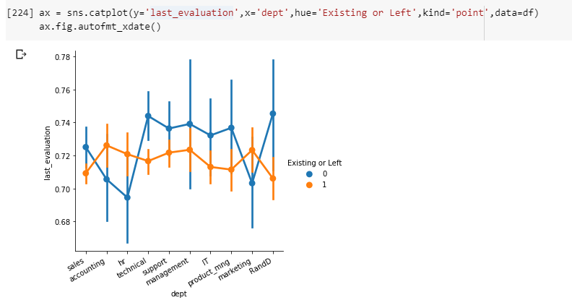
Last Evaluation vs Department
From this graph, we can infer that the employees who are leaving company from department → technical, support, management, IT, product management and R&D have last evaluation more than 0.73

Slide 6
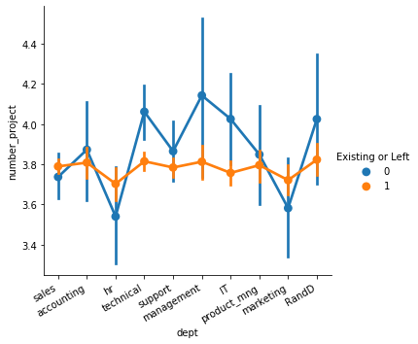
Number of Projects vs Department
From this graph, we can infer that the employees who are leaving company from department → accounting, technical, support, management, IT, product management , R&D having mean number of projects greater than 3.8

Slide 7
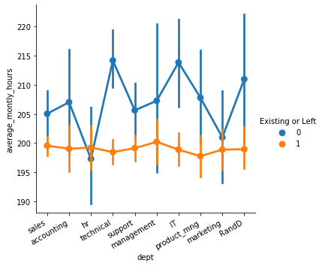
Average Monthly Hours vs Department
From this graph, we can infer that the employees who are leaving company have average monthly hours almost greater than 205 hours or 6.6 hours per day

Slide 8
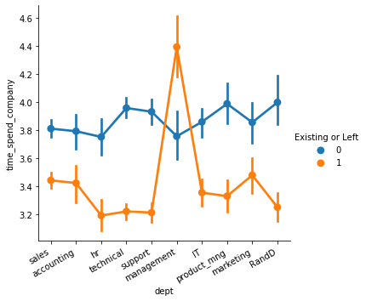
Time spend in company vs Department
From this graph, we can infer that the employees who are leaving company have mean time spent in company in between 3.5 and 4 years.

Slide 9
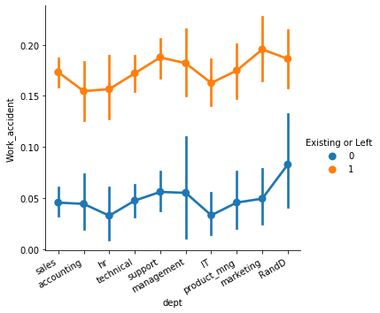
Work accident vs Department
From this graph, we can infer that the employees who are leaving company have mean work accident in each department in company is less than 0.1.

Slide 10
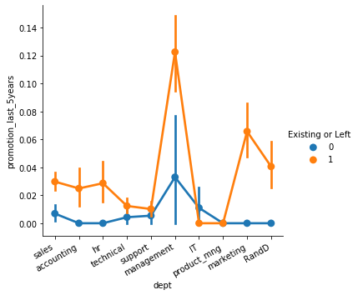
Promotion in last 5 years vs Department
From this graph, we can infer that the employees who are leaving company have mean promotion in last 5 years in each department in company is less than 0.03.

Slide 11
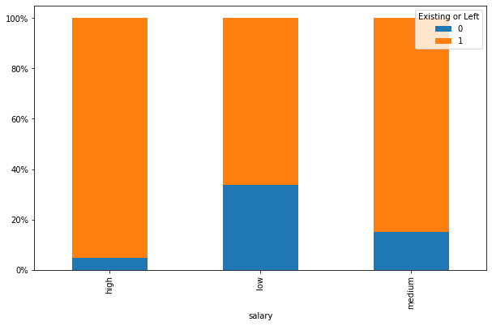
Salary
From this graph, we can infer that the employees who are leaving company in this most of the employees have low salary and very less than employees who left have medium salary.

Slide 12
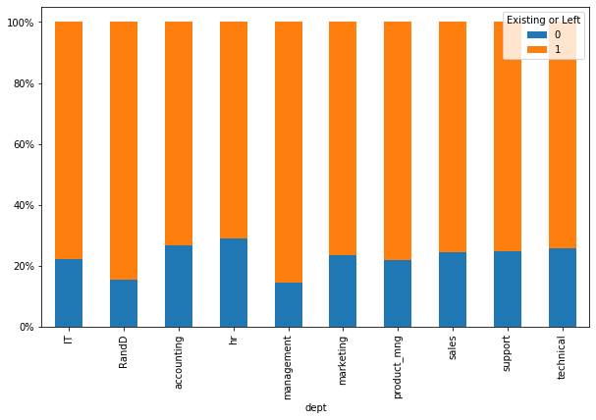
Department
From this graph, we can infer that the employees who are leaving company in this most of the employees were from hr and accounting department.

Slide 13
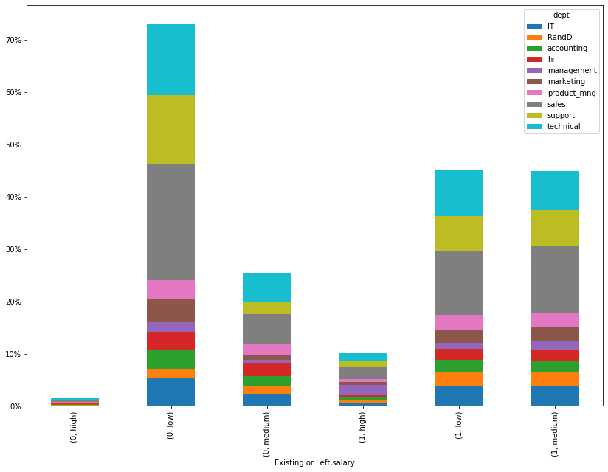
Salary and Department
We can infer that the employees who are leaving company have low salary and from sales, support or technical department or have medium salary and from hr department

Slide 14
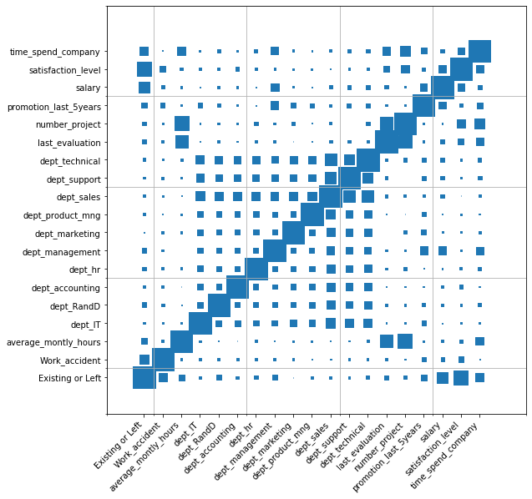
CORRELATION PLOT
We can see that column existing or left is highly correlated with the satisfaction level, salary, time spent in company and work accident.

Slide 15
Now after doing data visualization, we applied machine learning algorithm → Random Forest Classifier with gridsearchCV which gave us accuracy of 98.9% from this we found out the employees who are going to leave which are having same pattern as that of the employees who left the company X.

Slide 16
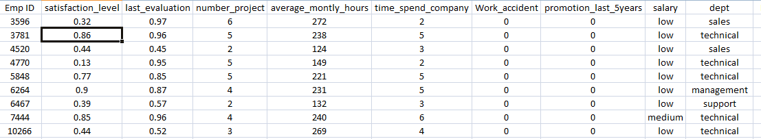
So the employees who are going to leave the company X is given below :-

